Slide 1
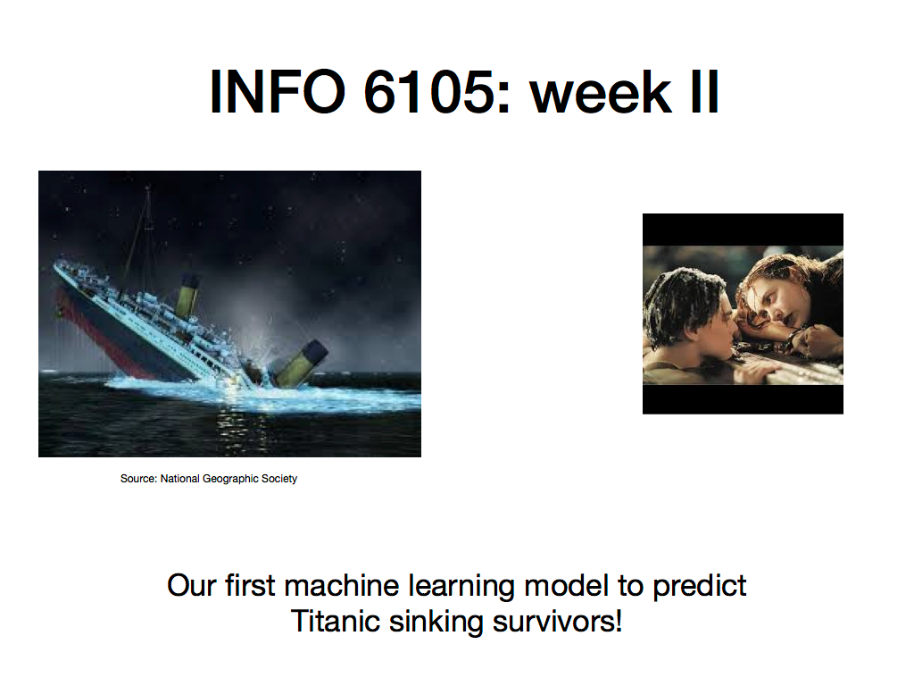
Who survived?

Slide 2
Learning from disaster: old Kaggle competition
Please see https://www.kaggle.com/c/titanic for more details.
The challenge we set for ourselves for the next two weeks is this:
We have data about passengers who travelled on the Titanic when the ship sunk
Some passengers survived the ship’s sinking, others did not
From historical/archival data, we know who survived and who did not.
We also have data about the passengers themselves (name, age, class they travelled, fare paid, etc.)
Instead of looking at the survived/not survived column of data, can we use machine learning (use data on all other passenger data) to predict who survived and who did not?
Data can either be download from Kaggle link, or use data supplied to you

Slide 3

This is a classification problem !
Bin I or class I
“Survived”
Predict which bin they go to, or classify the passengers.
Target variable or Y is Survived/Did not survive
Bin II or class II
“Did not survive”
Passengers on board the Titanic

Slide 4

How to go about this?
Q: How do we avoid this logical fallacy?
Ans: By using holdout sets to evaluate the model performance!
Source: https://insights.principa.co.za
~1300 rows (Titanic dataset)
~70%
~15%
~15%
Validation set
Test set

Slide 5
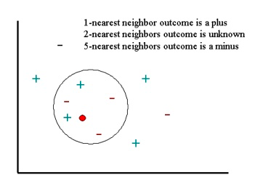
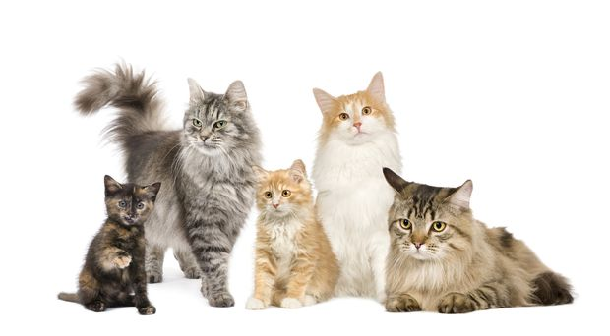
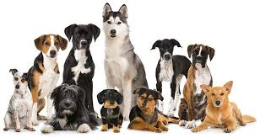
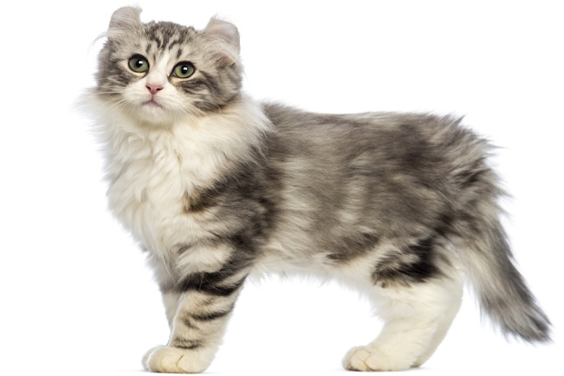
K-nearest neighbors (kNN), a simple ML algorithm
Item # | Distance to unknown | Class of item
1 | 12 | Cat
2 | 2 | Cat
3 | 1 | Dog
4 | 4 | Dog
5 | 5 | Cat
6 | 8 | Dog
7 | 2.5 | Cat
8 | 3 | Cat
9 | 7 | Dog
10 | 9 | Cat
Many different metrics can be used to
measure distance. Simplest is Euclidan.
Weight (lbs)
Height (inches)
Cat (class II)
Dog (class I)
Cat
Unknown

Slide 6
Learn more: Readings, external resources
http://vision.stanford.edu/teaching/cs231n-demos/knn/
Pages 163 through 168 of this free book download here http://www-bcf.usc.edu/~gareth/ISL/ISLR%20Seventh%20Printing.pdf
Different measures of distance used in machine learning and in k-NN: https://towardsdatascience.com/importance-of-distance-metrics-in-machine-learning-modelling-e51395ffe60d

